Slide 1
Countries in Need of Help

Slide 2
The modes of clustering used :
K-Means Clustering
Hierarchical Clustering using Dendrogram.

Slide 3
Data :
Index: 167 entries, Afghanistan to Zambia
Data columns (total 9 columns):
# | Columns | D-Type
1 | Child Mortality | float64
2 | Exports | float64
3 | Health | float64
4 | Imports | float64
5 | Income | int64
6 | Inflation | float64
7 | Life Expectancy | float64
8 | Total Fertility | float64
9 | GDP | int64

Slide 4
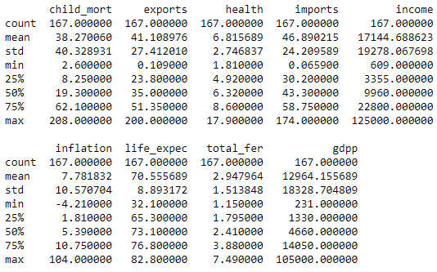
Statistics of Data :

Slide 5
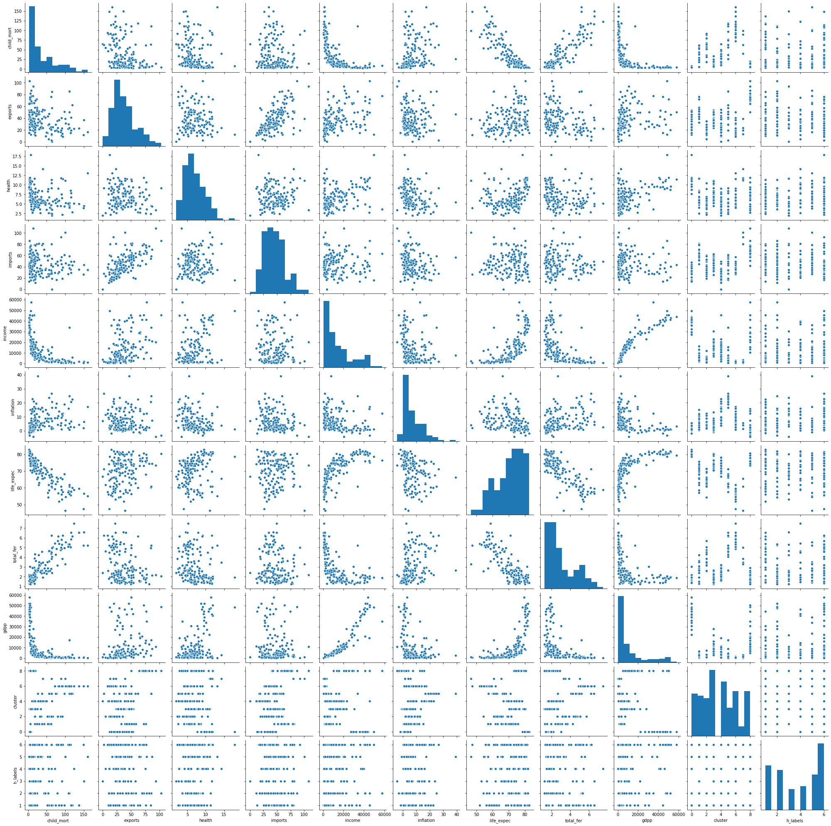

Slide 6
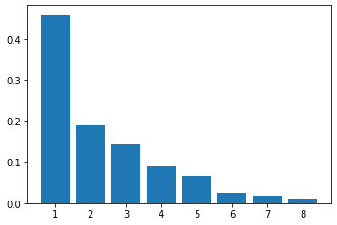
Feature Selection :
Features were scaled using Standard Scaler
The scaled features were fitted and transformed using Principal Component Analysis to reduce the dimensions.
5 components were selected.
The total data explained by 5 components = 0.949

Slide 7
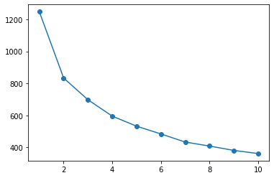
K-Means :
The number of clusters selected are 9.
The relation between the number of clusters and inertias is explained by the graph.

Slide 8
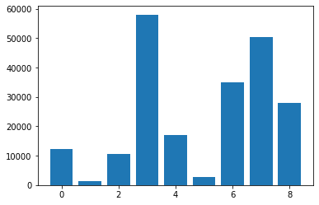
GDP vs Clusters :
G
D P
Clusters

Slide 9
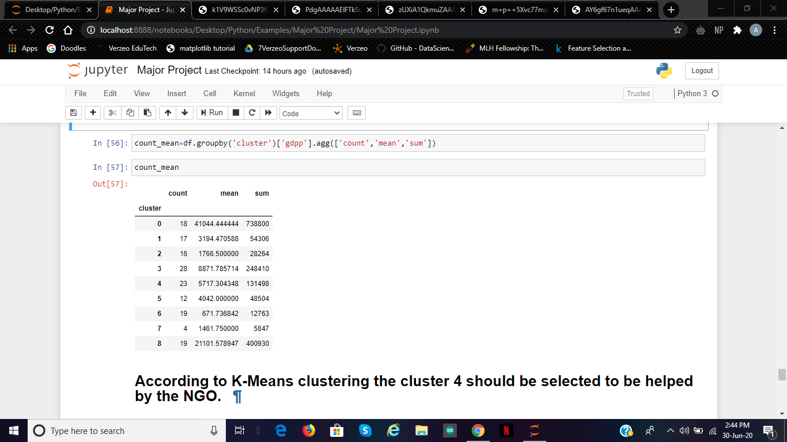
Stats using K-Means :

Slide 10
Countries selected using K-Means :
Afghanistan
Benin
Burkina Faso
Burundi
Cameroon
Central African Republic
Chad
Comoros
Cote d’Ivoire
Gambia
Guinea
Guinea-Bissau
Kenya
Madagascar
Malawi
Mali
Mozambique
Niger
Rwanda
Senegal
Sierra Leone
Tanzania
Togo
Uganda
Zambia

Slide 11
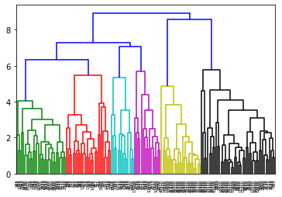
Dendrogram

Slide 12
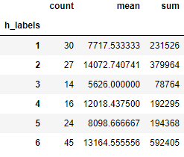
Stats using Hierarchical Clustering :

Slide 13
Countries to be helped using Hierarchal Clustering :
Armenia
Benin
Brazil
Burkina Faso
Cape Verde
Czech Republic
Egypt
Equatorial Guinea
Eritrea
Iran
Kazakhstan
Libya
Madagascar
Malawi
Mauritius
Montenegro
Pakistan
Peru
Romania
Tanzania
Turkey
Turkmenistan
Uganda
Vanuatu

